Slide 1
Real-time Global Illumination
Introduction to a Many-light based Method using Sparse Voxel Octree
Che Sun
Advisor: Emmanuel Agu
Master’s Thesis
Computer Science Department, WPI

Slide 2
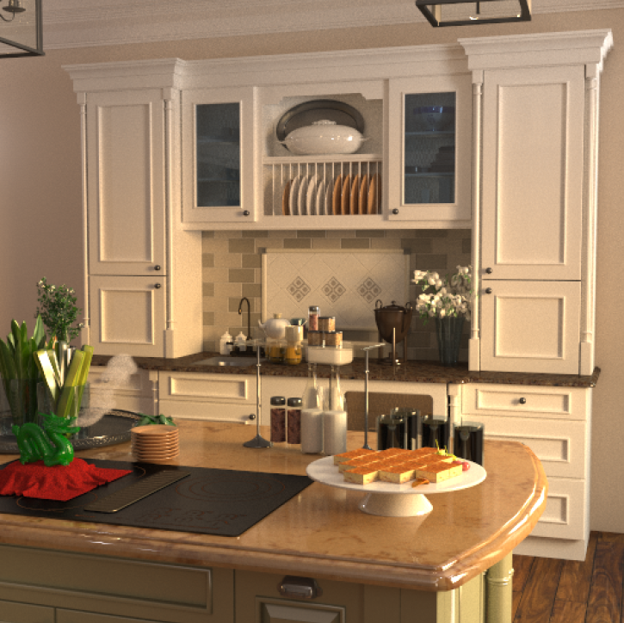
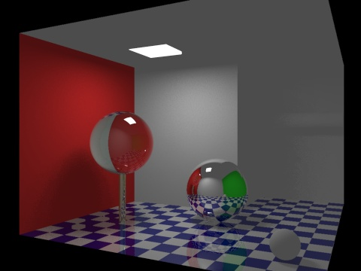
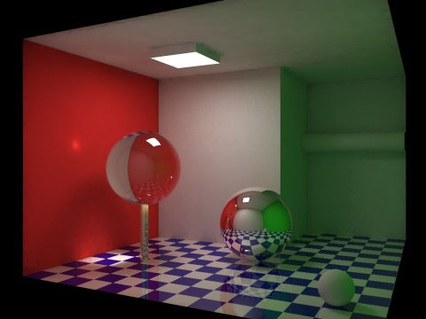
What is Global Illumination?
A general name for a group of algorithms used in 3D computer graphics
Create photorealistic images
Take into account not only the light
coming directly from a light source
(direct illumination), but also indirect
light bounced off from other objects
(indirect illumination)

Slide 3
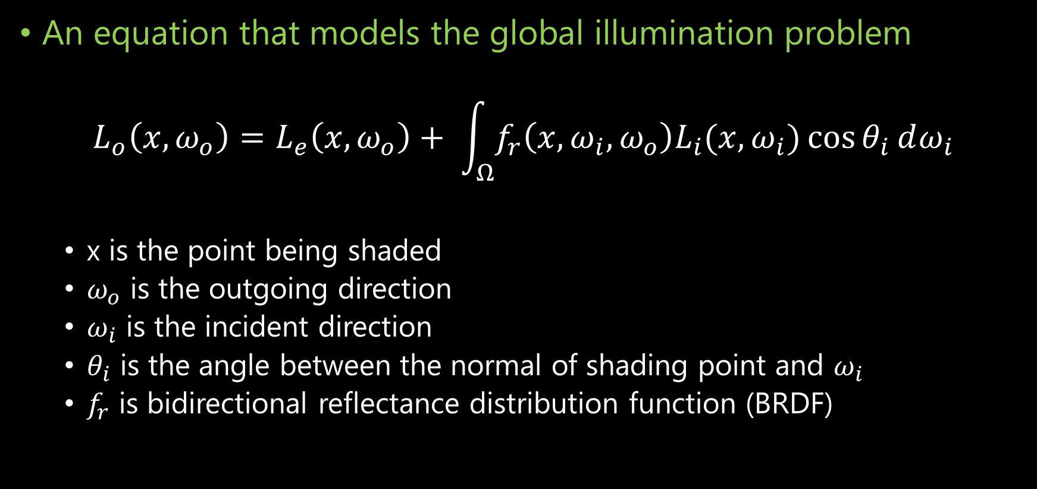
The Rendering Equation
An equation that models the global illumination problem
$$L_{o}\left(x, ω_{o}\right)=L_{e}\left(x, ω_{o}\right)+ \int_{Ω}^{ }{f_{r}\left(x, ω_{i}, ω_{o}\right)L_{i}(x, ω_{i})\cos{θ_{i}}}ⅆω_{i}$$
x is the point being shaded
$ω_{o}$ is the outgoing direction
$ω_{i}$ is the incident direction
$θ_{i}$ is the angle between the normal of shading point and $ω_{i}$
$f_{r}$ is bidirectional reflectance distribution function (BRDF)

Slide 4
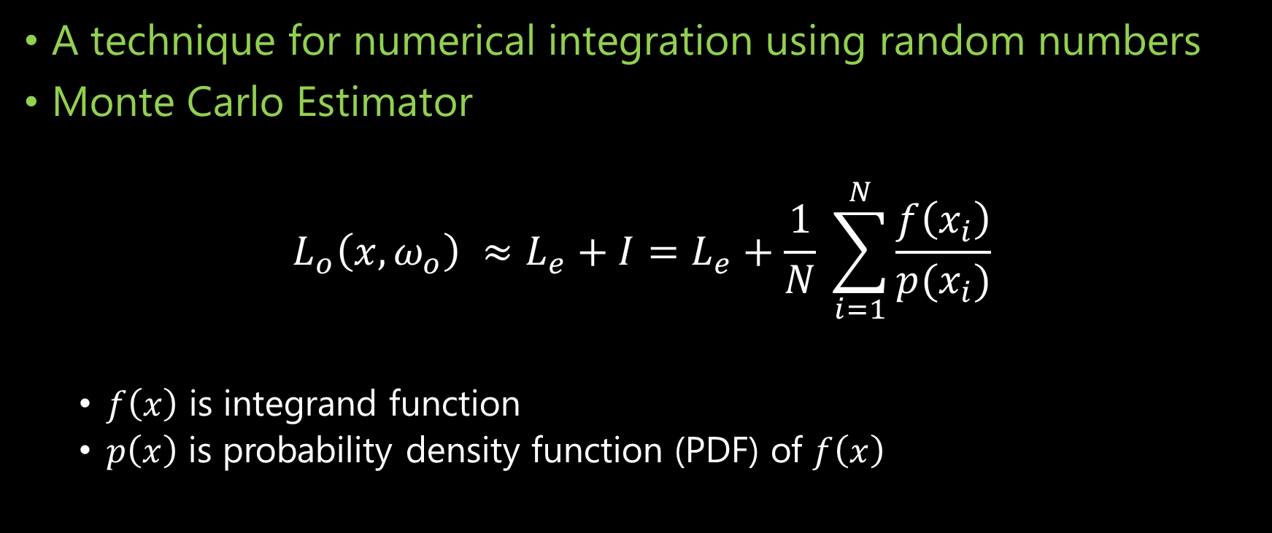
Monte Carlo Integration
A technique for numerical integration using random numbers
Monte Carlo Estimator
$$L_{o}\left(x, ω_{o}\right) ≈L_{e}+I=L_{e}+\frac{1}{N} \sum_{i=1}^{N}{\frac{f\left(x_{i}\right)}{p(x_{i})}}$$
$f\left(x\right)$ is integrand function
$p\left(x\right)$ is probability density function (PDF) of $f\left(x\right)$

Slide 5
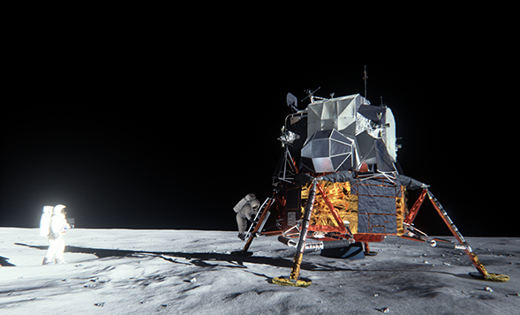
State-of-the-art
Real-time Monte Carlo Methods
Many-light based method
Voxelization based method
Image-space based method
Real-time Partial Differential Equation (PDE) based Method
Numerical PDE solver of diffusion equation

Slide 6
What I have been doing?
Study state-of-the-art real-time global illumination methods
Got 43 papers (including 2 master’s thesis and 1 PhD’s dissertation) investigated.
Try to come up with some idea(s) to accelerate real-time GI computation
Accelerating global illumination computation using sparse voxel octree
Try to construct a robust global illumination rendering framework (not a game engine)
An real-time global illumination framework containing 18,000 lines of code
Learn advanced shader programming skills, which is very cool!

Slide 7
A Novel Voxel-based Hybrid Method
Based on …
Dachsbacher, Carsten, et al. "Scalable Realistic Rendering with Many‐Light Methods." Computer Graphics Forum. Vol. 33. No. 1. 2014.
Thiedemann, Sinje, et al. "Voxel-based global illumination." Symposium on Interactive 3D Graphics and Games. ACM, 2011.
Crassin, Cyril, et al. "Interactive indirect illumination using voxel cone tracing." Computer Graphics Forum. Vol. 30. No. 7. Blackwell Publishing Ltd, 2011.

Slide 8
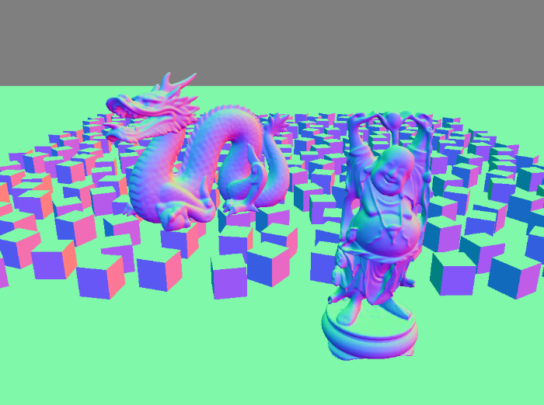
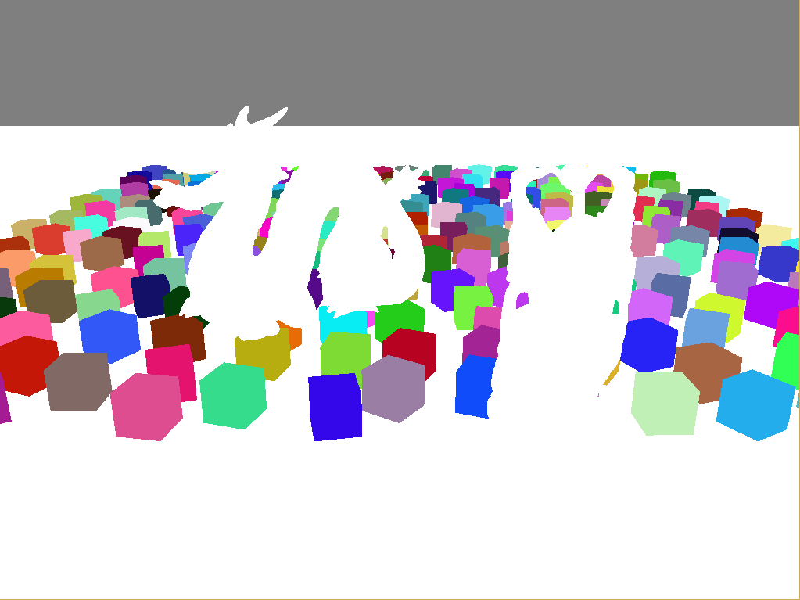
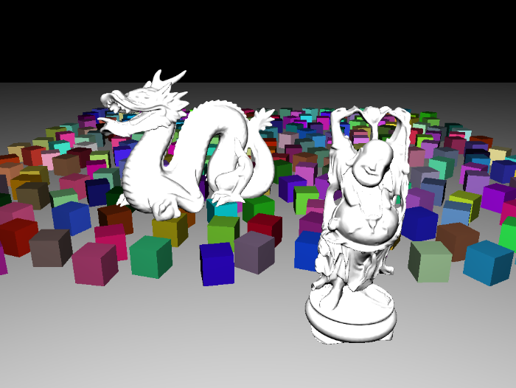
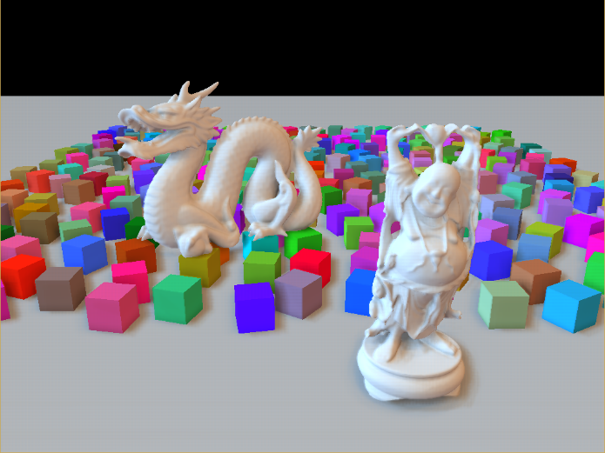

Background
G-buffer and Deferred Shading
A screen-space shading technique
Reduce the lighting
complexity from $O\left(m∗n\right)$
to $O(m+n)$
Stored in Multiple
Render Targets (MRT)

Slide 9
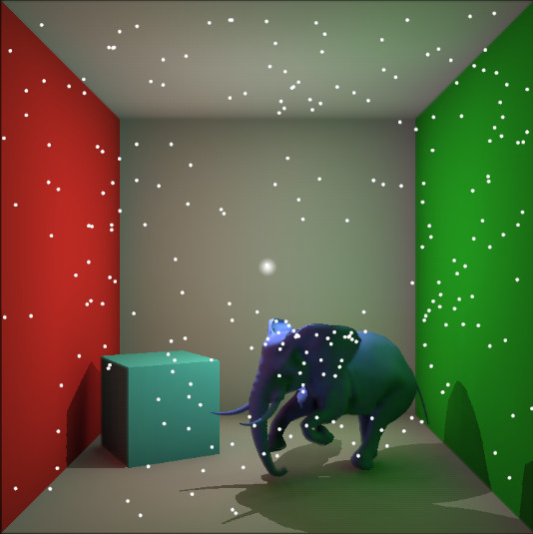
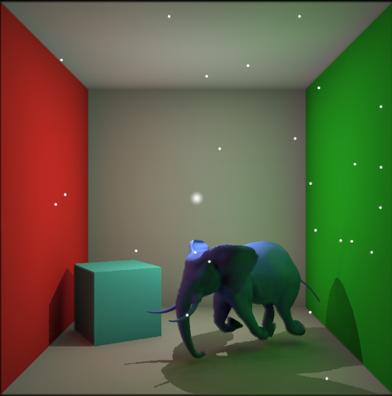
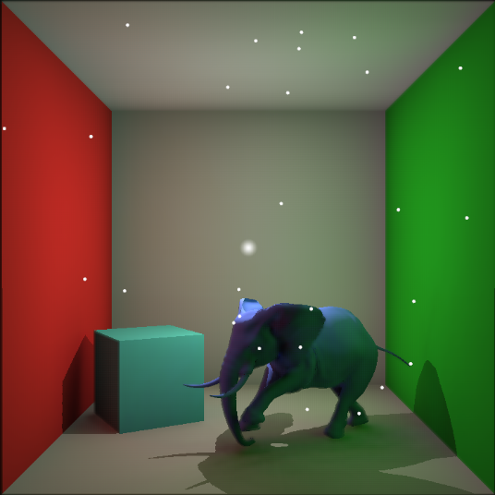
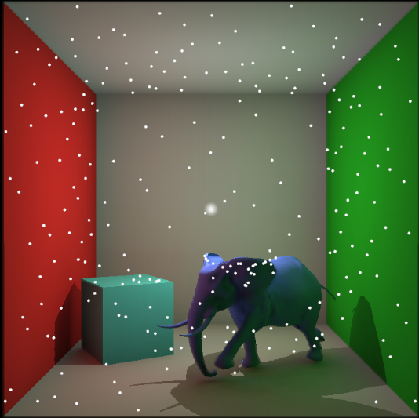
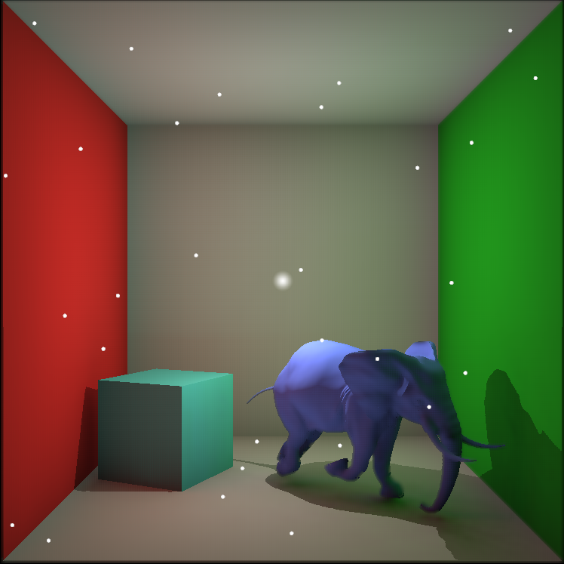
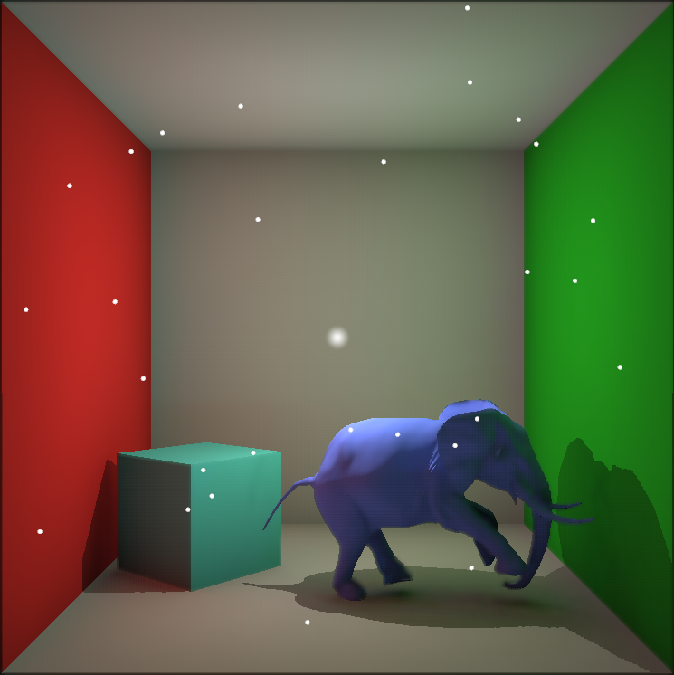
Background
Sampling of Incoming Radiance
Naïve pseudo-random sampling points generation
Low-discrepancy sampling points generation

Slide 10
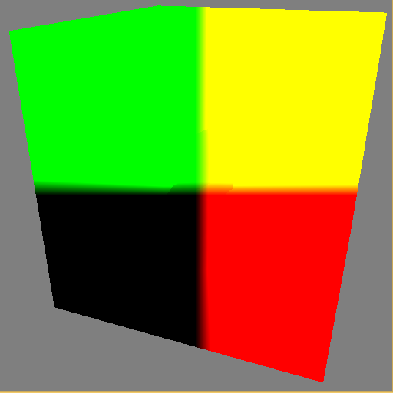
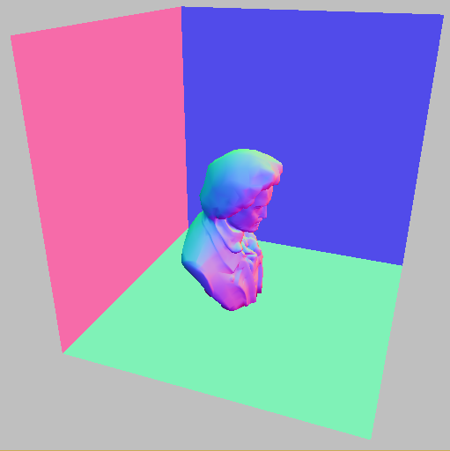
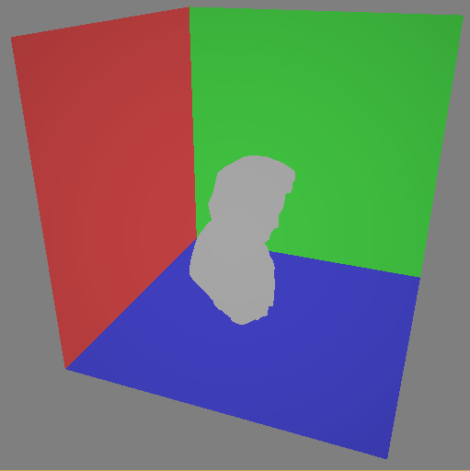
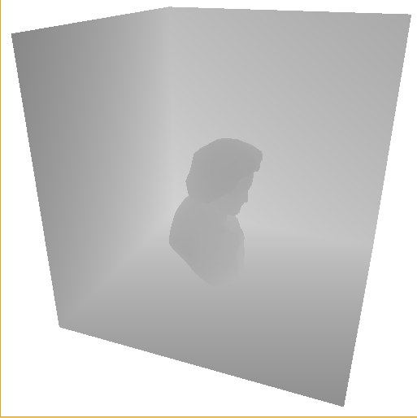
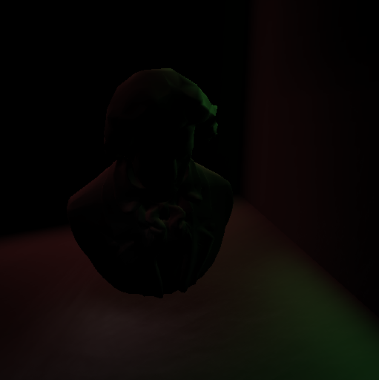
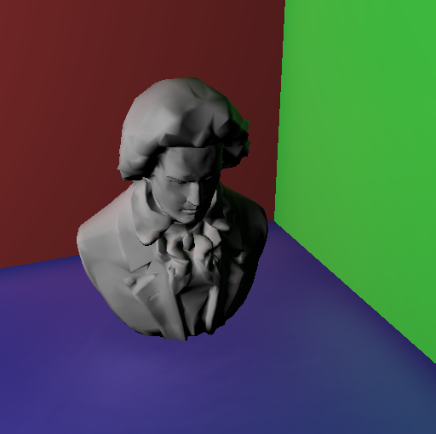
Background
Reflective Shadow Maps (RSM)
Capture direct lighting using MRT similar to G-buffer
Sample RSM and create virtual point lights in image space

Slide 11
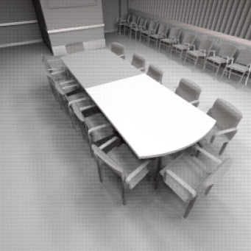
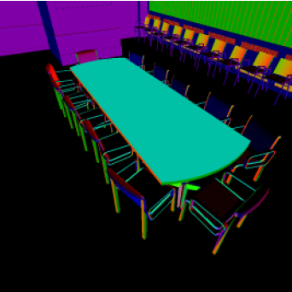
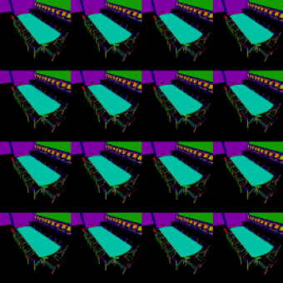
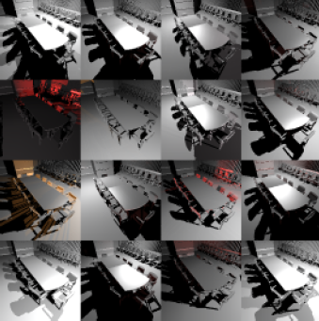
Background
Interleaved Sampling
Form an interleaved sampling pattern
Each pixel only samples a subset of
the original function

Slide 12
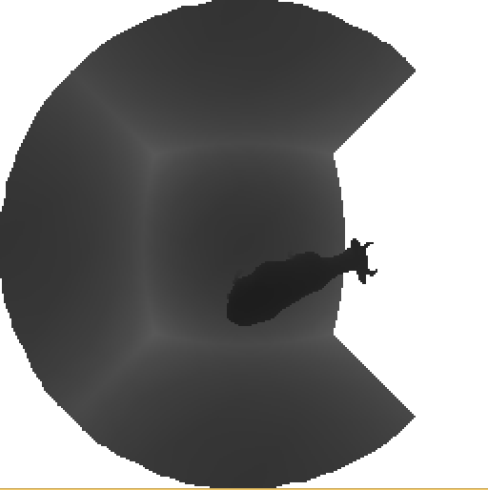
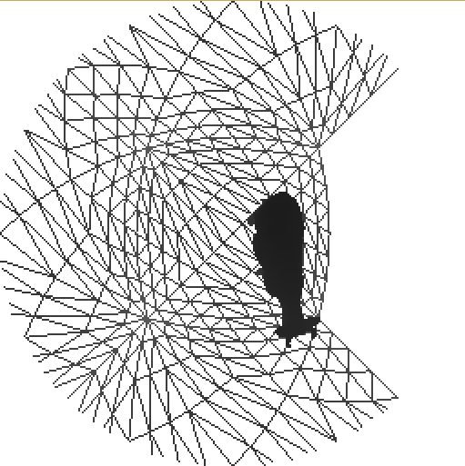
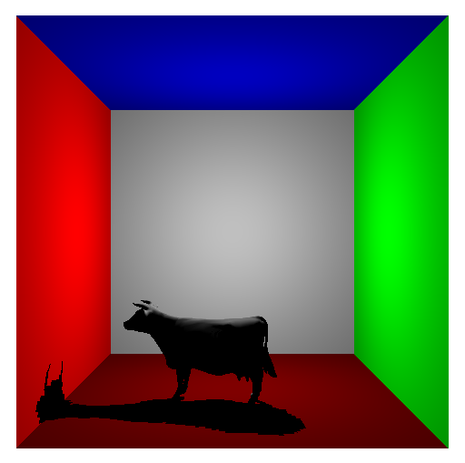
Background
VPL Shadow Maps (Paraboloid Shadow Maps)
Traditional Shadow Maps have limited field of view (FOV)
PSM can cover 180 degree field of view

Slide 13
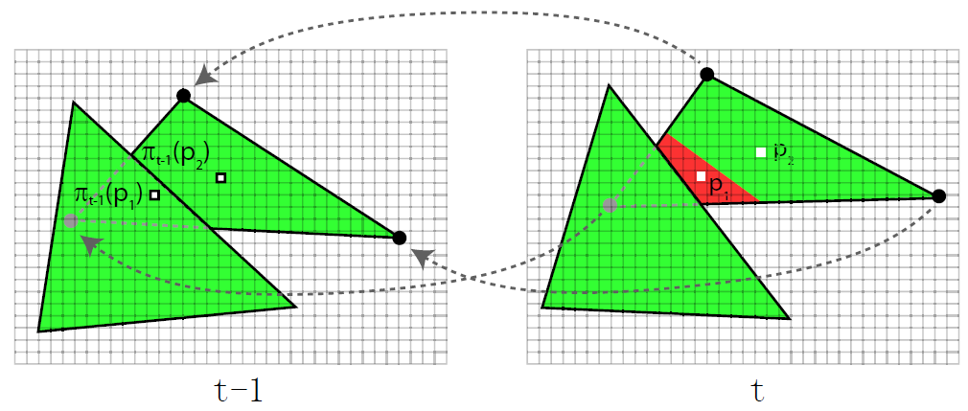
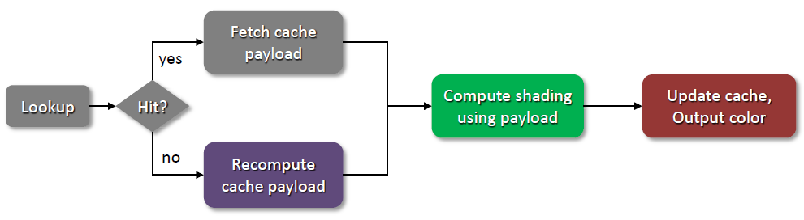
Background
Temporal Coherence
Cache and reuse the
current result
Amortized computation

Slide 14
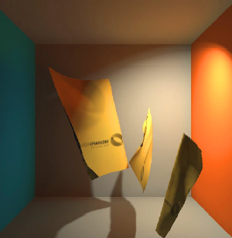
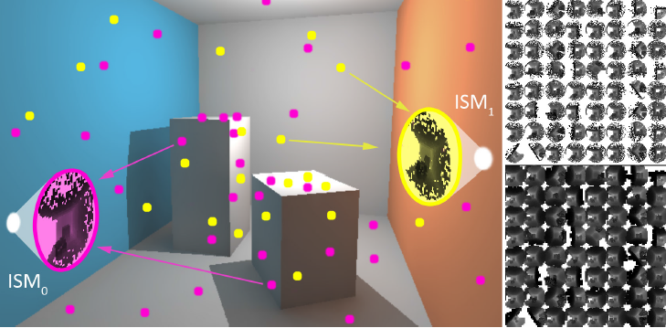
Background
Imperfect Shadow Maps
Pros
Fast and support fully dynamic scene
Cons
Limited by the maximum resolution of textures
Inaccurate approximation of shadow maps (Use pull-push to improve the quality)

Slide 15
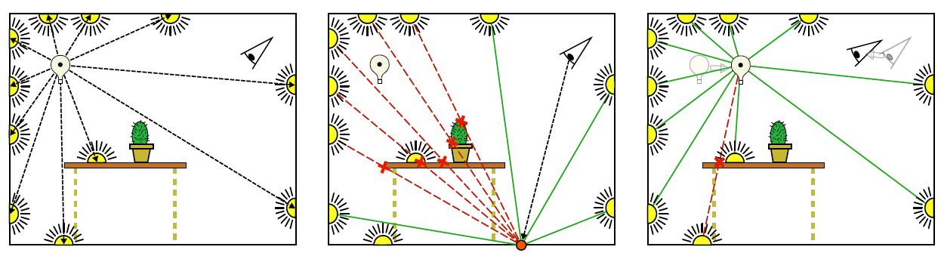
Background
Incremental Instant Radiosity
Pros
Faster then imperfect shadow maps
Cons
Cannot support fully dynamic scene

Slide 16
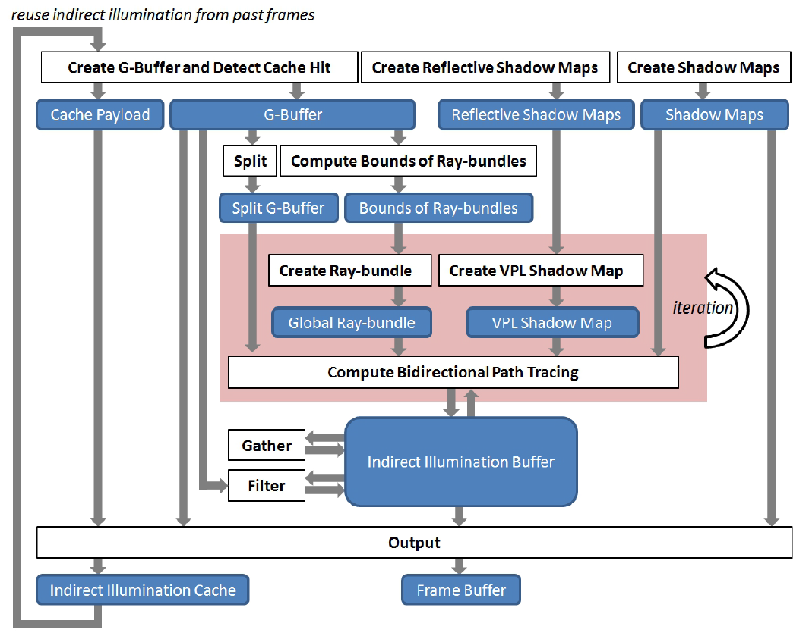
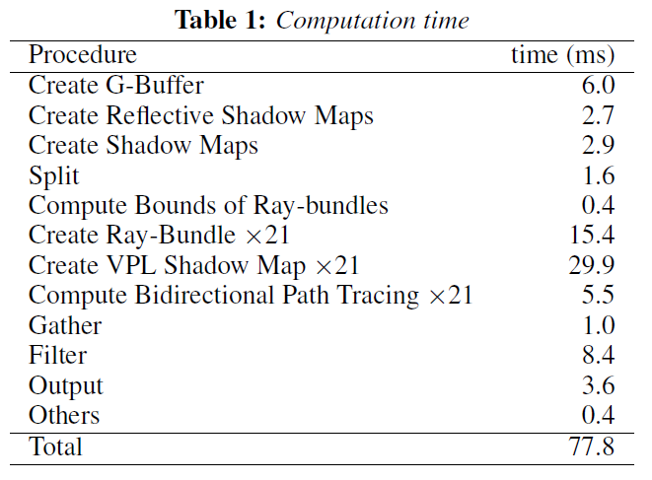
Real-time Bidirectional Path Tracing via Rasterization
Tokuyoshi, Yusuke, and Shinji Ogaki. "Real-time bidirectional path tracing via rasterization." Proceedings of the ACM SIGGRAPH Symposium on Interactive 3D Graphics and Games. ACM, 2012.
Current Issue - still too
SLOW !!

Slide 17
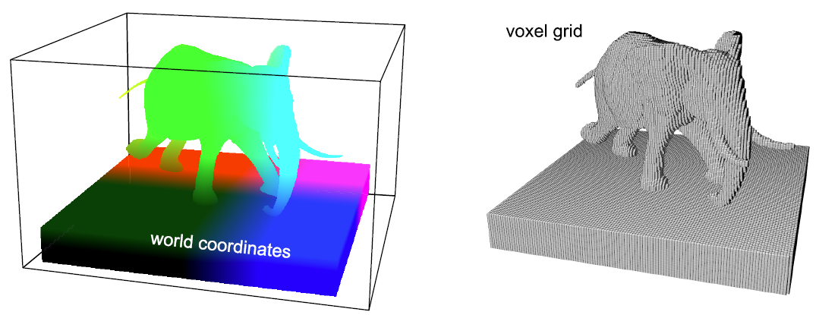
Background
Real-time Voxelization
Discretize the original function in which we are interested
Perform accelerated computation on the voxel grid

Slide 18
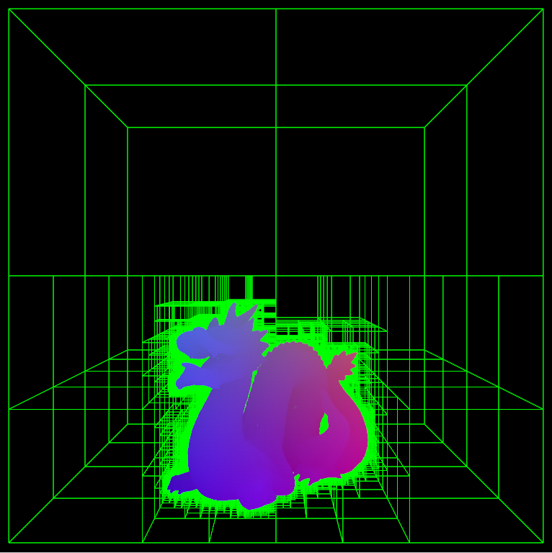
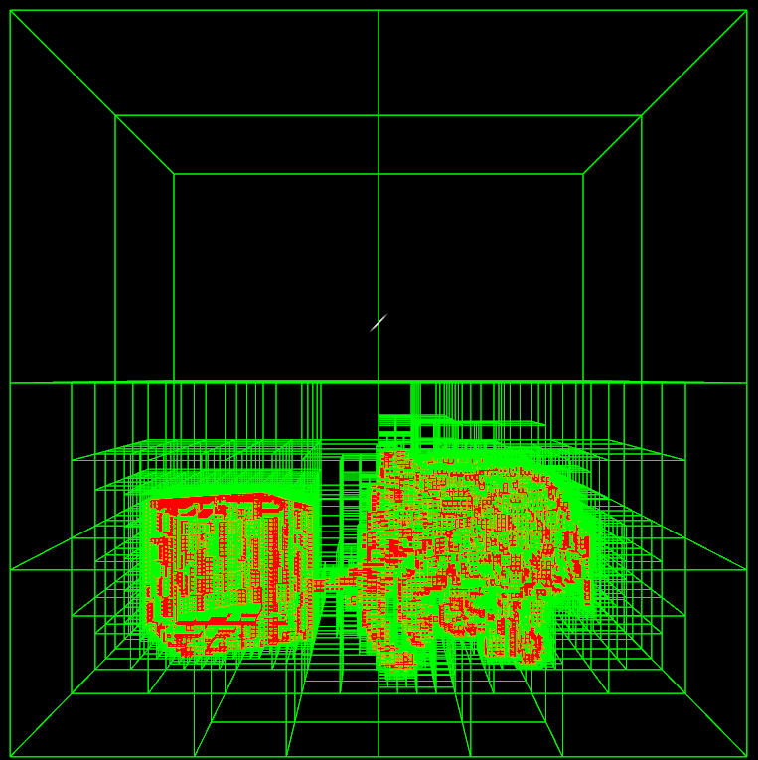
Background
Build Sparse Voxel Octree on GPU in Real-time
A 3D binary search tree that improves the search operation to o(logn)
Save a lot of GPU memory

Slide 19
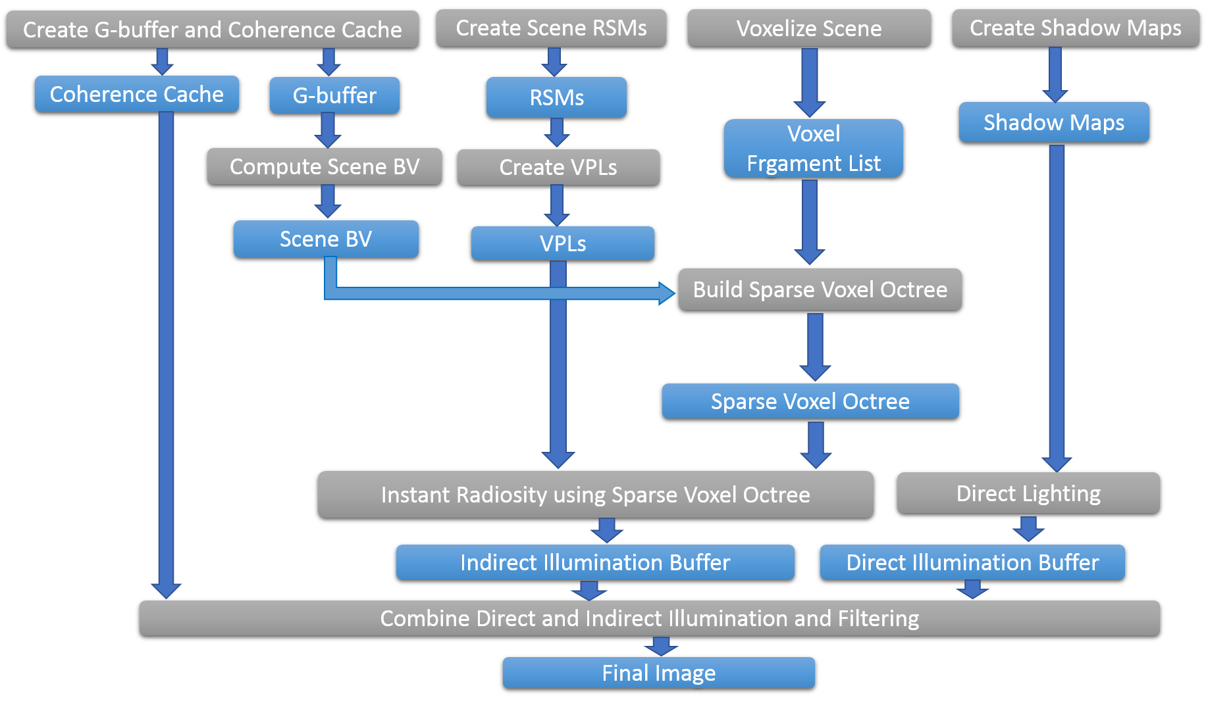
Our Improved Many-light based Real-time GI System
Data
Algorithm

Slide 20
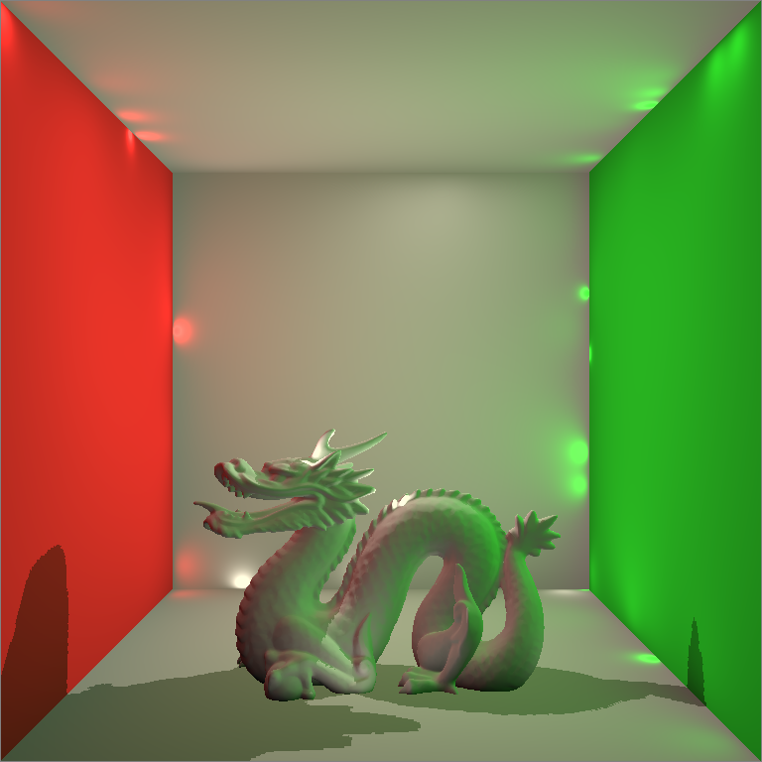
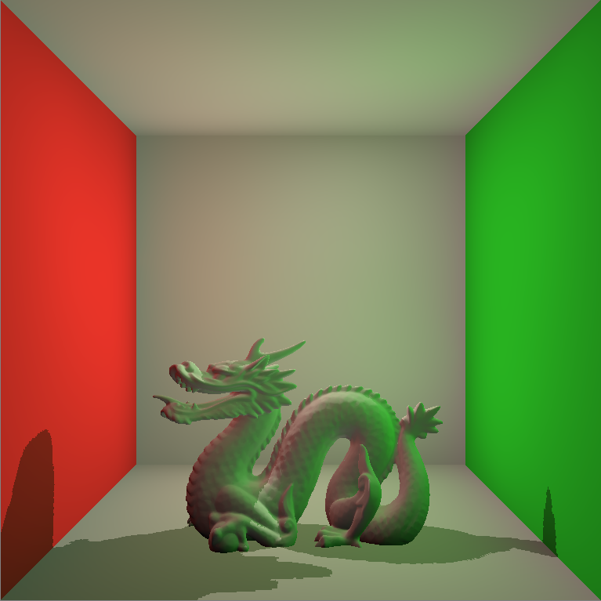
Real-time Virtual Point Lights Rendering
Naïve Implementation of Instant Radiosity
Depends on VPL Shadow Maps (Very slow!)
Classic Singularity Issue

Slide 21
Resolving the Singularity Issue by Clamping
Code Fragment
vec3 indirectColor = vec3(0.0, 0.0, 0.0);
for( int i = 0; i < VPLCount; ++i )
{
VPL vpl = VPLBuffer.vpls[i];
vpl.WorldNormal = vpl.WorldNormal*2.0 - 1.0;
vec3 incidentDir = PositionWorld.xyz - vpl.WorldPosition.xyz;
float len = length(incidentDir);
incidentDir = incidentDir / len;
float cos0 = max(0.0, dot(NormalWorld, -incidentDir));
float cos1 = max(0.0, dot(incidentDir, vpl.WorldNormal.xyz));
float geometricTerm = cos0 * cos1 / max(len*len, BounceSingularity);
indirectColor += MaterialColor.rgb * vpl.Flux.rgb * geometricTerm;
}
indirectColor = indirectColor * 2 * PI;
gl_FragData[0] = vec4(indirectColor, 1.0);

Slide 22
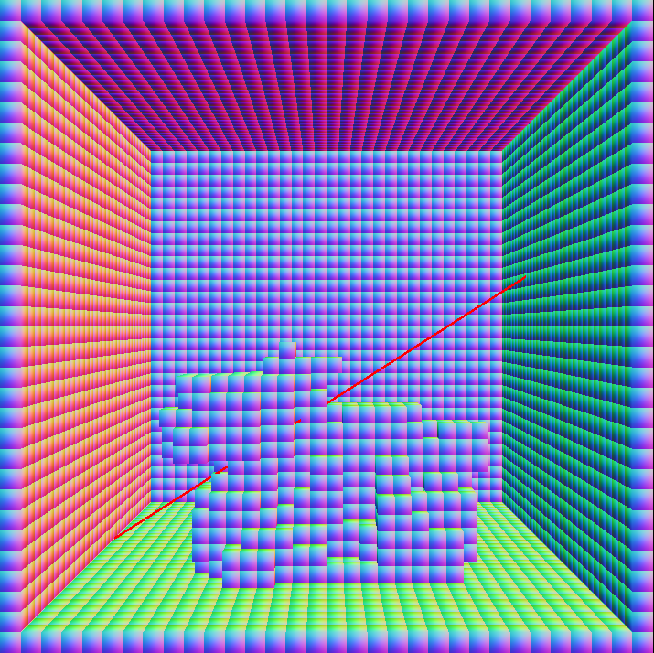
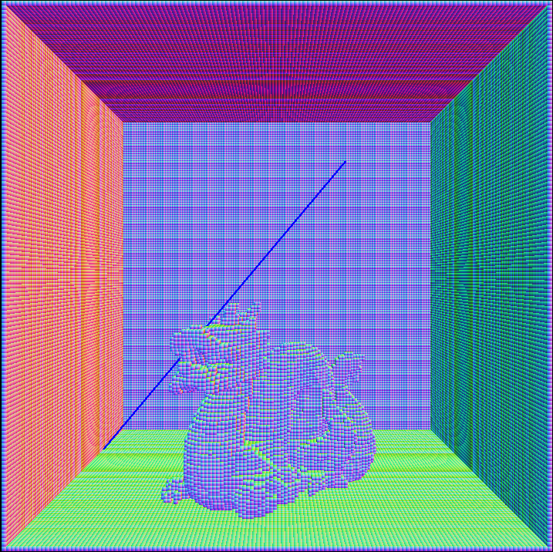
Resolving the VPL Shadow Maps Issue by Simple Voxelization
Visibility Tests by Shadow Maps
Visibility Tests by Regular Voxel Grid (My first try, still too SLOW)

Slide 23
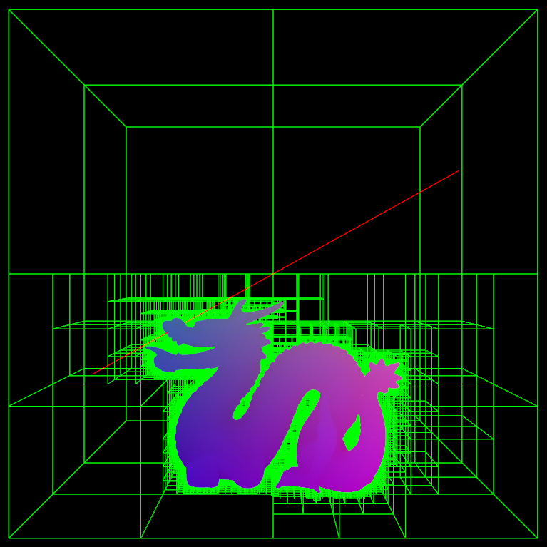
Resolving the VPL Shadow Maps Issue by Sparse Voxel Octree
Visibility Tests by Sparse Voxel Octree (An order of magnitude faster compared to my first try)

Slide 24
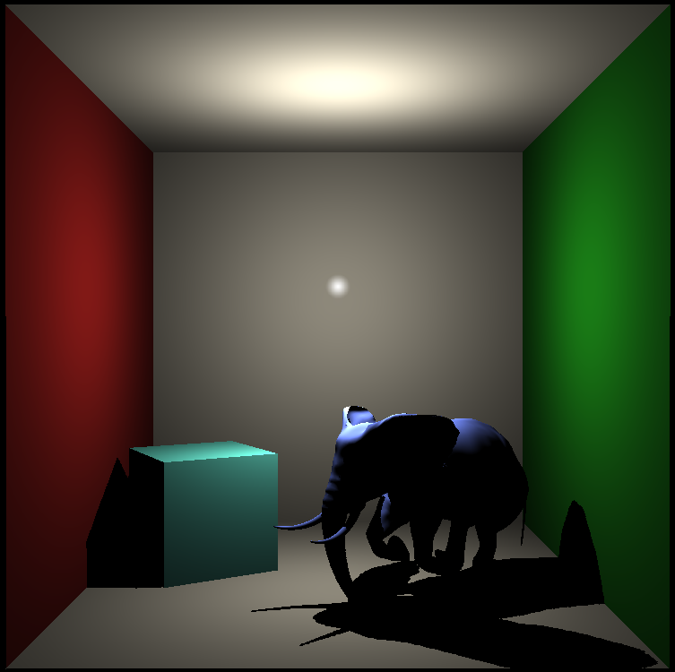
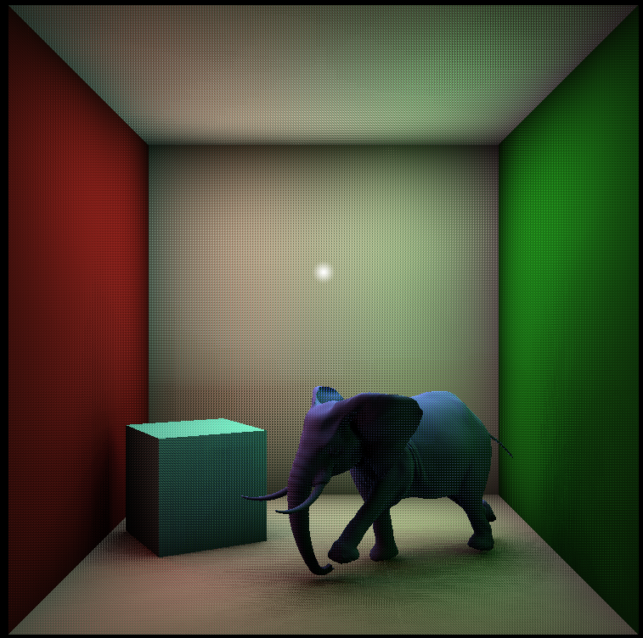
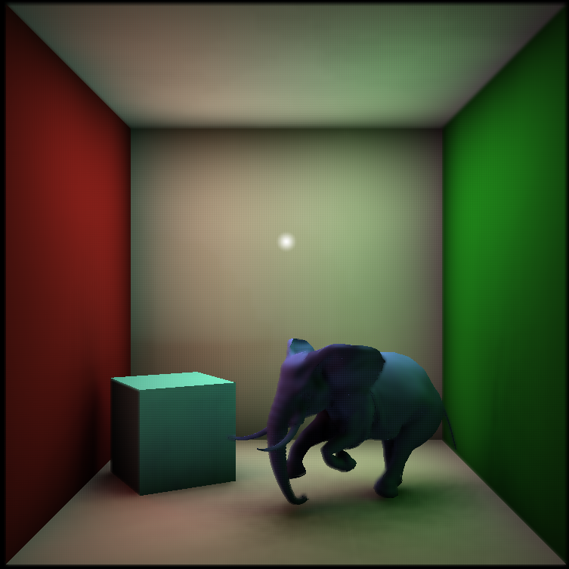
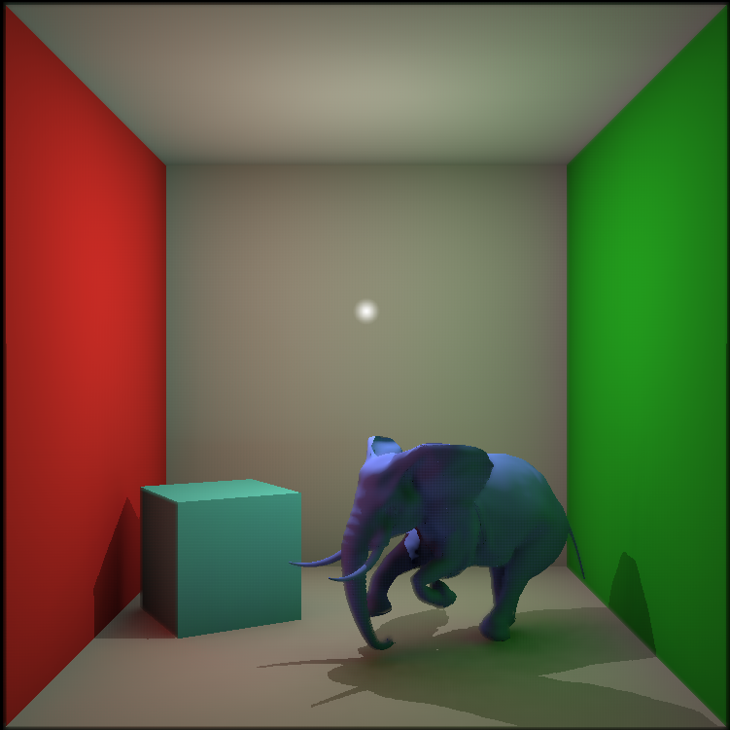
Rendering Results (27-30 fps)

Slide 25
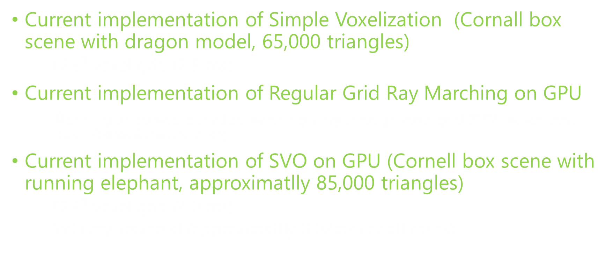
Performance of Voxel-based technique
Current implementation of Simple Voxelization (Cornall box scene with dragon model, 65,000 triangles)
${128}^{3}$ voxel grid (2.8 ms)
Current implementation of Regular Grid Ray Marching on GPU
Running on compute shader, marching a ray through voxel grid (0.02 ms for best case, 0.4ms for worst case)
Current implementation of SVO on GPU (Cornell box scene with running elephant, approximatlly 85,000 triangles)
${128}^{3}$ voxel grid (4.0 ms)
SVO ray traversal (approximatlly 0.02ms for all cases)

Slide 26
Advanced Shader Programming via Shader Model 5.0
OpenGL 4.3 Specification
Shaders
Vertex Shader
Tesselation Control Shader
Tesselation Evaluation Shader
Geometry Shader
Fragment Shader
Compute Shader
Improved GPU Memory Programming Model
Shader Atomic Operations
GPU Memory Random Access Model (Structured Buffer)
Avoid CPU-GPU Interaction
Indirect Command Buffer

Slide 27
Research Schedule
January – April 2014
Learn OpenGL shader programming, Spherical harmonics, Light Propagation Volume, Reflective Shadow Maps, SSDO, Instant Radiosity, Many-light methods then Implement SSDO.
May – August 2014
Learn OpenCL and OpenGL compute shader programming, Real-time Bidirectional Ray Tracing via Rasterization, GPU concurrent link list technique, Global Ray-bundles, Imperfect Shadow Maps, Incremental Instant Radiosity and Interleaved Sampling. Meanwhile, implement Reflective Shadow Maps, GPU concurrent link list and global ray-bundles.
September – December 2014
Learn OpenGL geometry and tessellation shader programming then investigate Real-time voxelization, Temporal Coherence, Paraboloid Shadow Map, Caustic Maps. Meanwhile, implement VPL demo, voxelization demo and combine VPL and voxelization together to support voxel-based VPL visibility test.
January – April 2015
Implement sparse voxel octree construction and its traversal on GPU then combine all the sub-systems together. Run tests and do debugging work.
June – October 2015
Write thesis, do thesis presentation and submission.

Slide 28
Thank You!
Any Questions? jazzboysc@gmail.com

